Slide 1
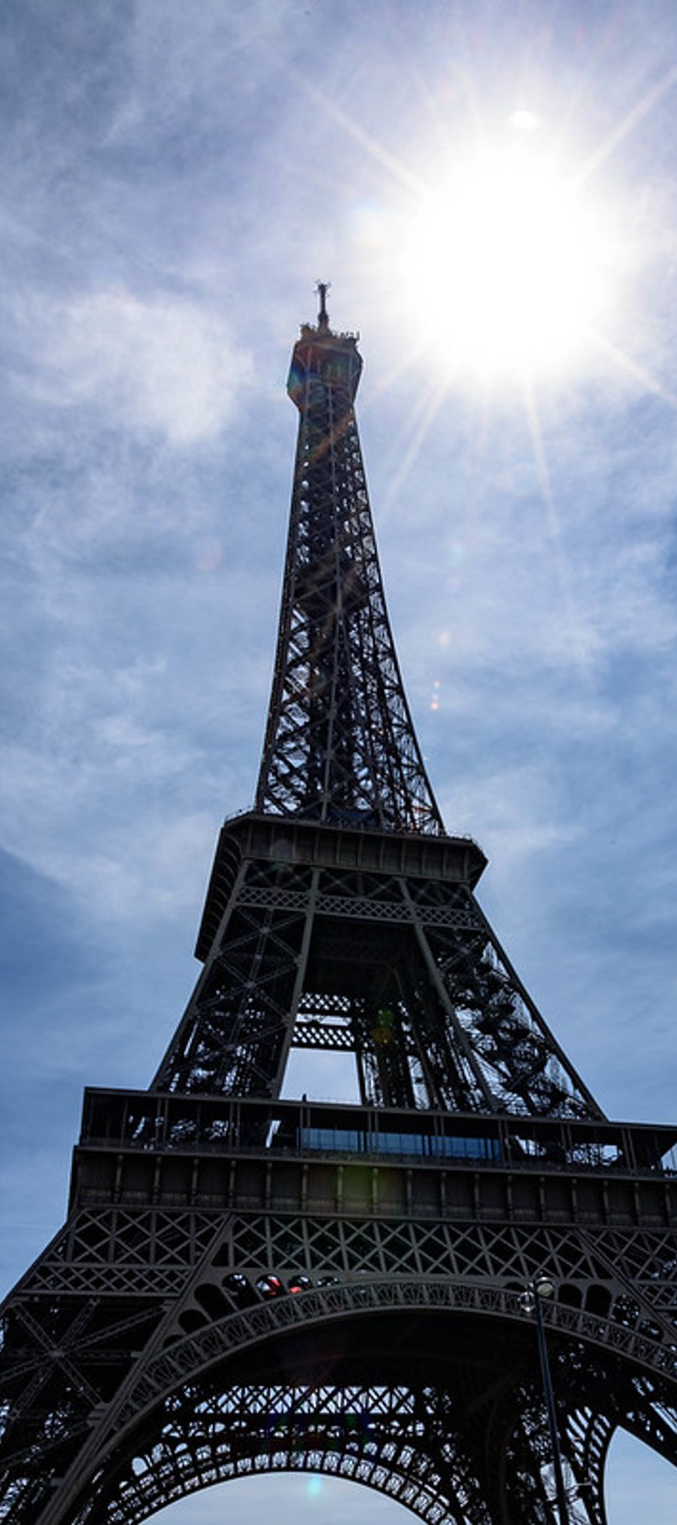
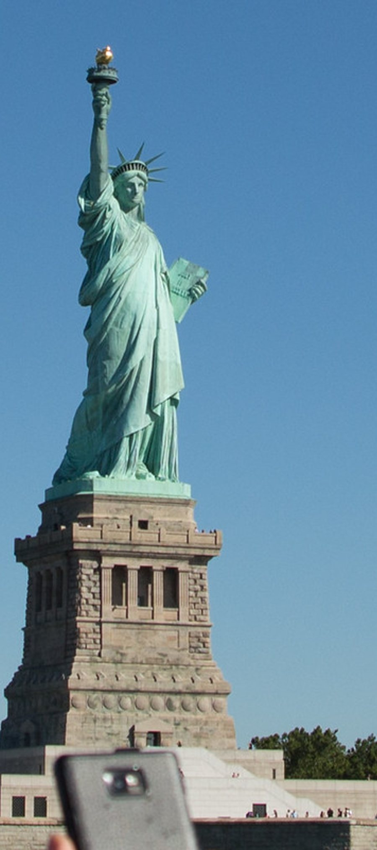
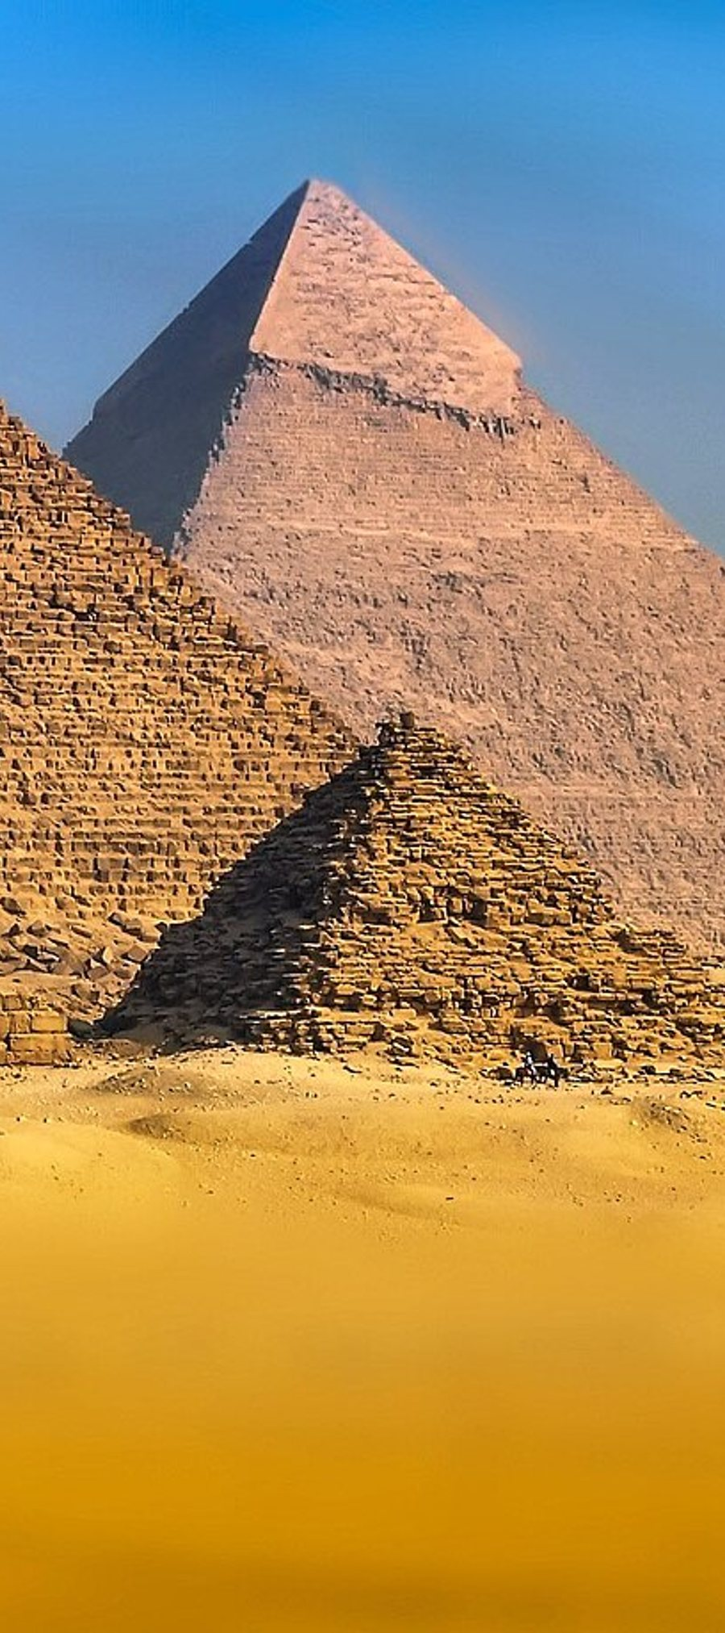
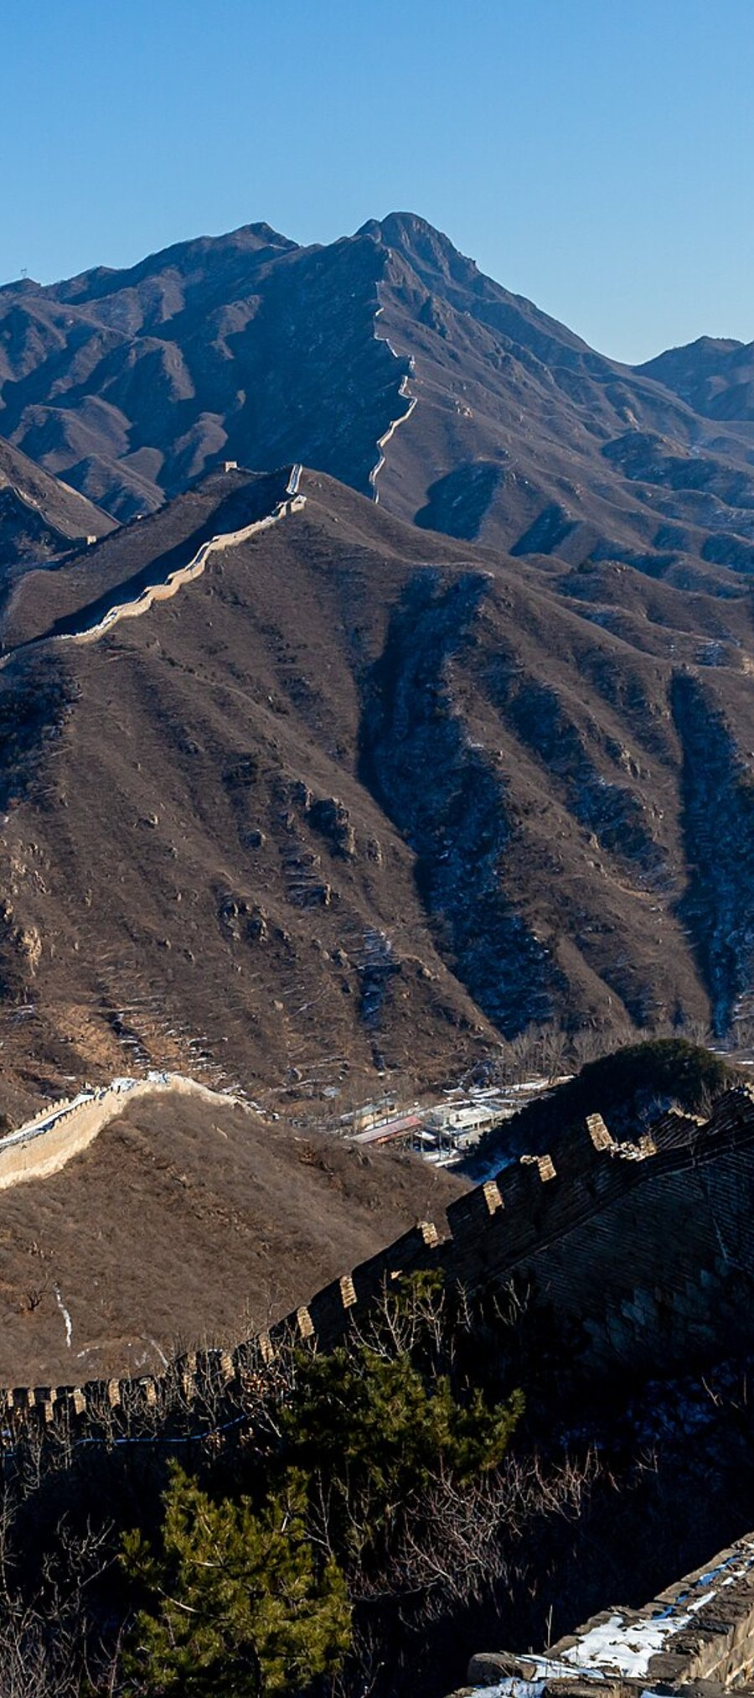

Wonderful World Landmarks
An Exciting Global Geography Adventure

Slide 2

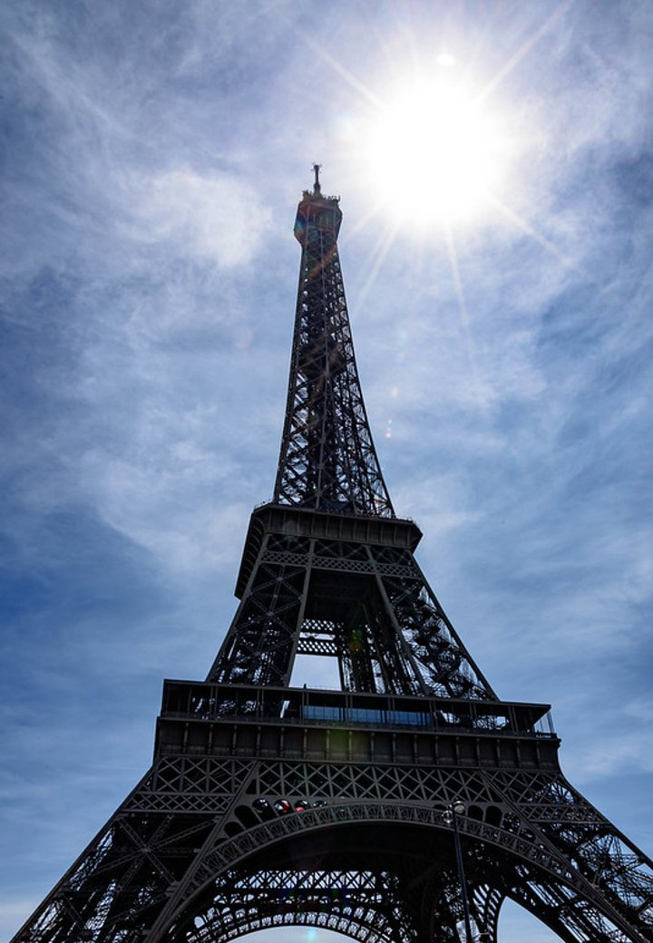
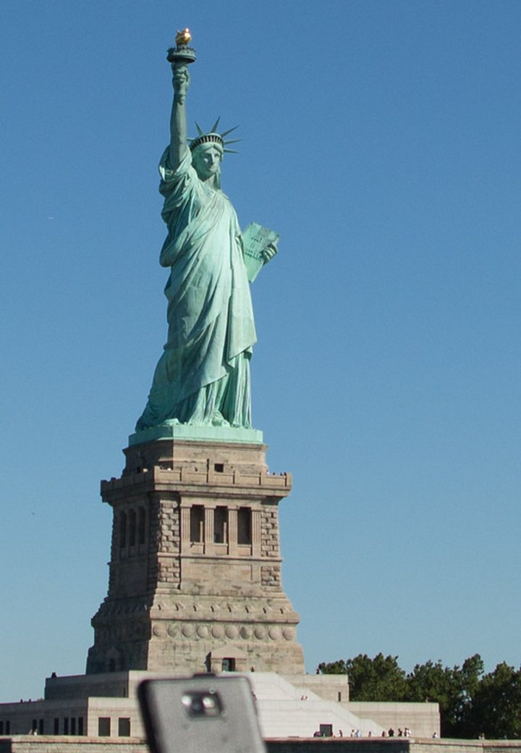






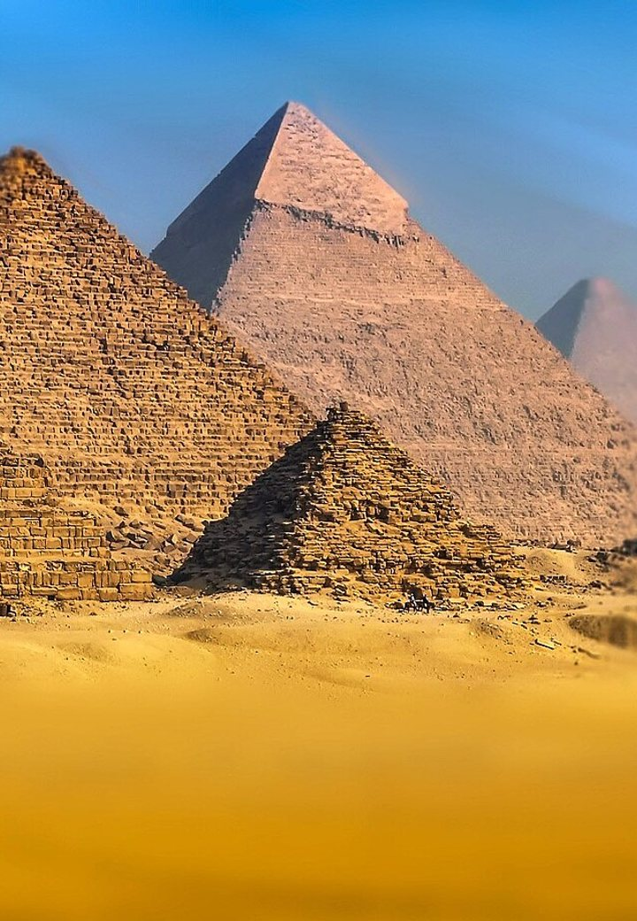
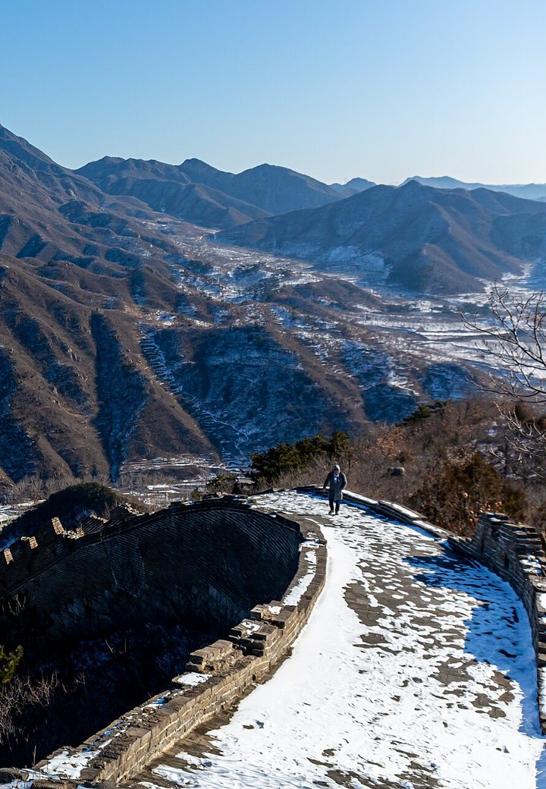





Presenting the Landmarks!
Eiffel Tower
Statue of Liberty
France
USA
Built in 1889
Gift from France in 1886
Over 300 meters tall
Welcomes visitors to New York
Pyramids of Giza
Great Wall of China
Egypt
China
Built more than 4,500 years ago
One of the longest structures ever built
One of the Seven Wonders of the Ancient World
Stretches thousands of kilo meters
Wonderful World Landmarks
02 / 06

Slide 3

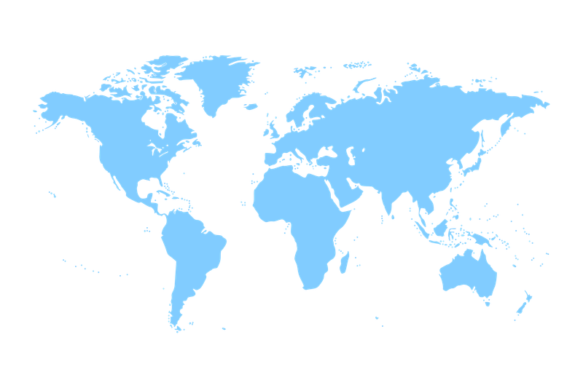
Let us use the map to locate them!
1
Eiffel Tower
Paris (France)
1
2
Statue of Liberty
2
New York (USA)
4
3
3
Pyramids of Giza
(Egypt)
4
Great Wall
(China)
Wonderful World Landmarks
03 / 06

Slide 4

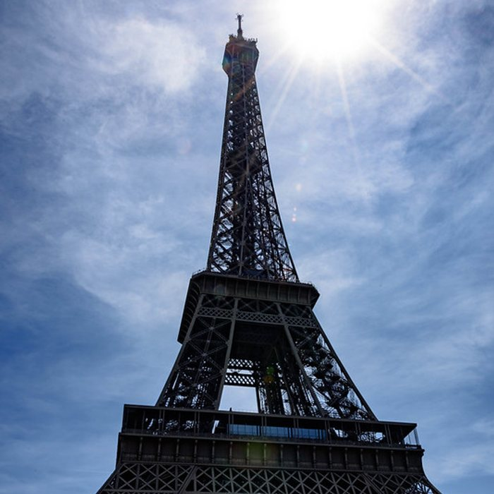
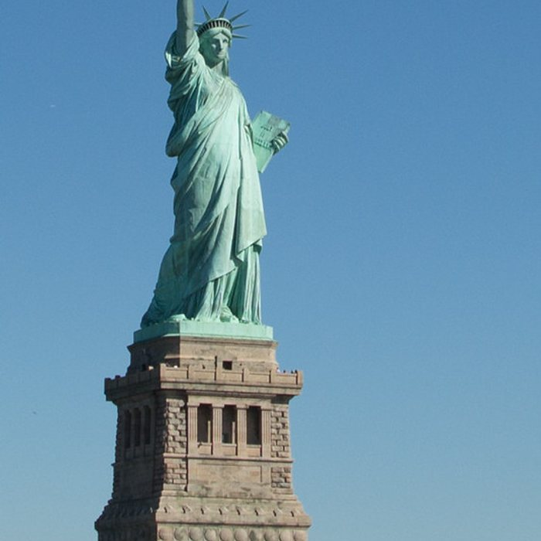
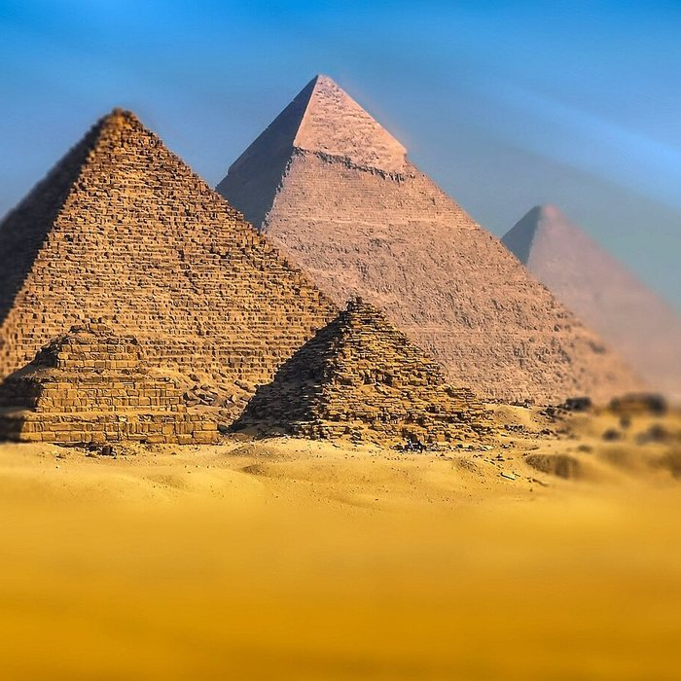
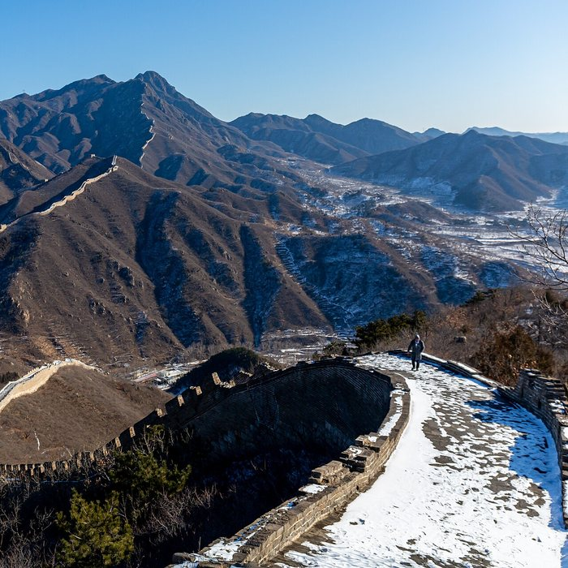
Did You Know?
Eiffel Tower
Statue of Liberty
Pyramids of Giza
Great Wall of China
In summers, The Eiffel Tower can grow taller because of heat !
The approximate shoe size of the Statue of Liberty is 879!
For almost 4,000 years, the pyramids stood as the highest man-made structures.
The Great Wall is so long that it stretches for more than 21,000 km
Wonderful World Landmarks
04 / 06

Slide 5


What Did We Learn Today?
QUICK QUIZ
The Eiffel Tower is located in which country?
1
Which landmark is found in Egypt?
2
Which landmark greets visitors as they enter New York Harbor?
3
Which is the longest landmark?
4
Wonderful World Landmarks
05 / 06

Slide 6

Resources / Sources
IMAGE CREDITS
SOURCES & FURTHER READING
“World Map” by shaire productions is licensed under CC BY 2.0.
“The Eiffel Tower, Paris” by Mustang Joe is marked with CC0 1.0.
“Statue of Liberty” by acruz0301 is marked with CC0 1.0.
“statue of liberty and base from below” by stevendamron is licensed under CC BY 2.0. To view a copy of this license, visit https://creativecommons.org/licenses/by/2.0/?ref=openverse.
“20200108 Great Wall of China walkway view-9” by Balon Greyjoy is marked with CC0 1.0.
“Pyramids in Giza - Egypt” by Walkerssk is marked with CC0 1.0.
“World map silhouette clipart, blue” is marked with CC0 1.0. To view the terms, visit https://creativecommons.org/publicdomain/zero/1.0/?ref=openverse.
Eiffel Tower - Wikipedia
https://interestingengineering.com/culture/the-eiffel-tower-grow-taller-each-summer
https://www.bloomberg.com/news/articles/2012-06-05/china-s-great-wall-found-to-measure-more-than-20-000-kilometers
https://parade.com/1199611/marynliles/did-you-know-facts/
https://www.sciencefocus.com/science/egyptian-pyramids-new-studies
Wonderful World Landmarks
06 / 06

